Slide 1
In The Name Of God

Slide 2
Preparation for labor and childbirth

Slide 3
labor pain is one of the most intense types of pain.
Parous women had lower pain scores than
nulliparous women, but responses varied widely.
Pregnant women and their support person(s) obtain information about childbirth and analgesia from many sources , including obstetricians, childbirth preparation classes , lay periodicals, books and pamphlets, family, friends,and increasingly the Internet.

Slide 4
A woman's experience of birth and
her birth memories is important .
Four factors are particularly important in determining a woman's childbirth experience:
----personal expectations
----the amount of support she receives
----the quality of the caregiver-patient relationship
---- her involvement in decision-making .
ns

Slide 5
We know about :
the role of pain in labor
the hormonal physiology of labor and childbirth
the wide and ever increasing number of ways that women find comfort during labor and birth
the importance of continuous emotional and physical support during parturition .
In addition, some traditional birth practices(movement during labor, physiologic pushing , and the upright position for second stage) .

Slide 6
Goals Of Preparation For Labor And Birth :
Confident in their own ability to give birth
Able to find comfort as labor progresses
Supported by family, friends, and professionals

Slide 7
What Women Need To Know
The normal, natural physiologic process of labor and birth
What facilitates normal physiologic labor
What makes giving birth normally more difficult
Signs of labor; distinguishing prodromal from active labor
When and how to call the health care provider
What to expect in the hospital, policies, and resources
Ways that laboring women find comfort; the importance of labor support
freedom of movement

Slide 8
The role of pain in labor:
the physiology of endogenous and exogenous oxytocin
Women learn that actively working with pain, rather than eliminating it
Women are encouraged to actively respond to their contractions during the first stage of labor
and to push when they feel the urge during second stage .
If women are actively able to work with their contractions in labor they experience a sense of accomplishment, feel less pain, and do not suffer.

Slide 9
Possible complications of labor (eg, prolonged labor, nonreassuring fetal heart rate): both prevention and management
How routine interventions and complications influence the normal course of labor
Newborn issues (infant needs and capabilities, the importance of keeping mother and baby together, rooming-in)
The importance of breastfeeding for mother and baby
What to expect when the baby goes home, including planning for support

Slide 10
natural childbirth:
Is used to describe a method of childbirth where medical intervention for management of pain or labor is minimized:
exercise regimen
controlled deep breathing
light massage
concentrating on a focal point
active support by a labor coach
gave the woman's partner an active, major role
reducing stimuli :turning down the lights, speaking quietly, giving a warm bath, and stressing gentleness.
Self-hypnosis and deep relaxation
yoga
importance of keeping mother and baby together

Slide 11
The following examples illustrate some of the benefits of childbirth education:
Fewer visits to labor delivery for assessment.
have both psychological and medical benefits.
reduced the likelihood of medication for pain relief, operative vaginal delivery, c/s. slight reduction in the length of labor and improvement in maternal satisfaction
Less use of epidural anesthesia.
(visualization and relaxation, breathing, meditation, yoga, acupressure, and facilitated partner support).
Reduction in elective inductions.
Increase in breastfeeding rates.

Slide 12
.
What To Do To Prepare :
Much of the preparation for labor and birth happens quite naturally as pregnancy progresses.
Mother becomes attached to her baby as he makes his presence known with kicks and movement.
Physical changes occur: the cervix softens, contractions become noticeable.
talking with other women, sharing stories, and getting guidance .
viewing birth on video ; books ;websites

Slide 13
Birth plans :
Preparing for labor and birth involves creating a plan for assuring that the three things that help women cope with labor and birth are in place: confidence in herself, freedom to reduce discomfort in a variety of ways, and support of family, friends and professionals.
In the birth plan, the woman identifies what is important to her and what she needs to feel safe, supported and confident in labor
The birth plan is intended to be a living document that changes as circumstances change, acknowledging that medical interventions based on best evidence may be necessary if complications ensue.

Slide 14
The written birth plan serves several purposes:
It provides an opportunity for discussion between the woman and her partner or support team to ensure that all important issues are addressed.
what is personally important for the woman.
It helps women become actively involved in making decisions, an important component of childbirth satisfaction.
It serves as documentation of the agreement between the provider and woman acknowledging that circumstances can change.
written birth plans reduce conflicts and misunderstandings between women and their providers surrounding the birth by making agreements in advance about what will be done in a normal delivery and what will be necessary if an emergency arises.

Slide 15
What To Look For In A Preparation For Childbirth Class:
Formal childbirth preparation classes should be taught by a certified childbirth educator .
The childbirth educator is knowledgeable about the normal, natural process of birth, including strategies to facilitate labor and birth. She is up to date with the most current research about birth and maternity care practices. helps women make sense of what they are learning so they can ultimately make informed decisions about their labor and birth.
Childbirth classes should be small, with no more than 8-10 couples, to facilitate discussion .
classes should involve at least 12 h of instruction.
Traditionally, they are held over a period of weeks in the last trimester.

Slide 16
Class content at a very minimum should include:
The history of birth .
The normal, natural physiologic process of birth including the role of hormones during pregnancy, birth, and breastfeeding .
The care practices that promote, protect and support normal birth, including letting labor start on its own .
The role of pain in labor .
A wide variety of comfort measures for palliating of pain, including not only simple relaxation and breathing techniques, but position changes such as walking and rocking, massage, hydrotherapy, aroma-therapy, music, use of hot and cold water .

Slide 17
Ways to facilitate the progress of labor, such as ambulation
Indications for medical interventions .
The effect of interventions, including the epidural, on the normal course of labor and birth .
Strategies to minimize the influence of interventions .
Complications of the normal, natural process of labor and birth .
How to keep labor as normal as possible if interventions are required .
basic information about the importance of keeping mother and baby together, breastfeeding for mother and baby, and infant needs and capabilities.

Slide 18
● ●Basics topics SUMMARY AND RECOMMENDATIONS
●Four factors important in determining a woman's satisfaction with her childbirth experience are personal expectations, the amount of support she receives, the quality of the caregiver-patient relationship, and her involvement in decision making. (See 'Introduction' above.)
●The goals of childbirth education are to enable women to labor and give birth confidently, comfortably, and supported by the people around them Childbirth education helps prospective parents prepare for childbirth and parenthood by providing information on issues such as maternity care practices, pain relief, decision making during labor, infant and postnatal care, and breastfeeding.
●Childbirth education classes are a good way to prepare for birth. They provide an opportunity to meet with other pregnant women, share stories, obtain knowledge about pregnancy/labor/birth/postpartum issues, address fears and concerns, and devote time to focusing on preparing for birth.
This information helps women know what to expect during labor and birth, and provides a forum for ultimately making choices within the context of modern maternity care and developing a personal plan for birth.

Slide 19
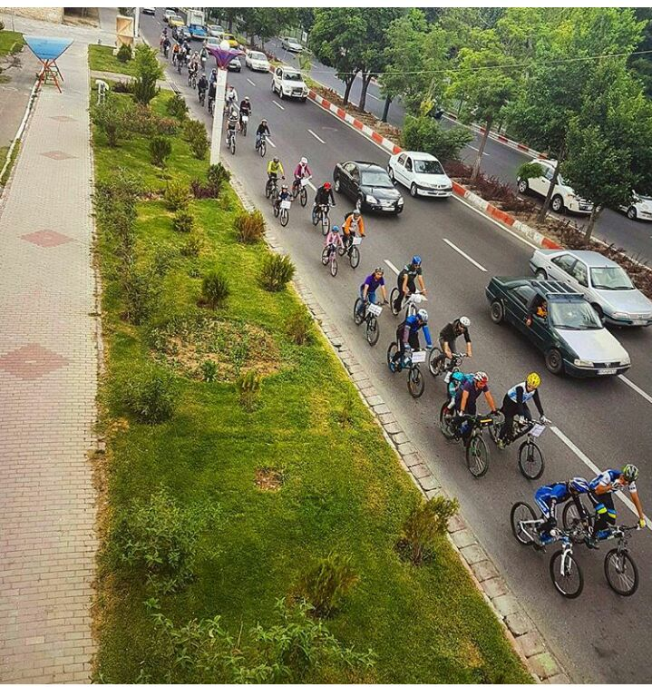
رکاب زنان سبز تبریز
هدف ما گسترش فرهنگ دوچرخه
و سه چرخه سواری
برای ترافیک کمتر
هوایی پاک
جسم و روحی سالم
09397301303

